Slide 1
Search Operators
For Google & Bing

Slide 2
Google First

Slide 3
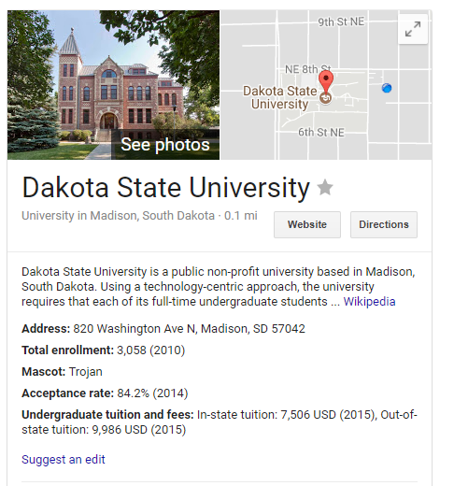
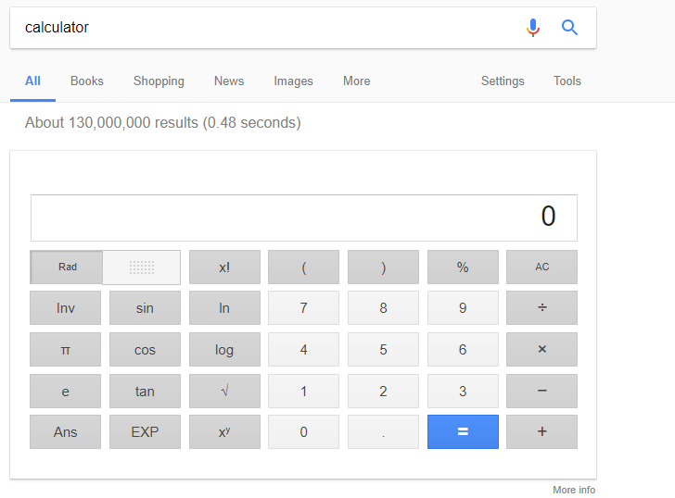
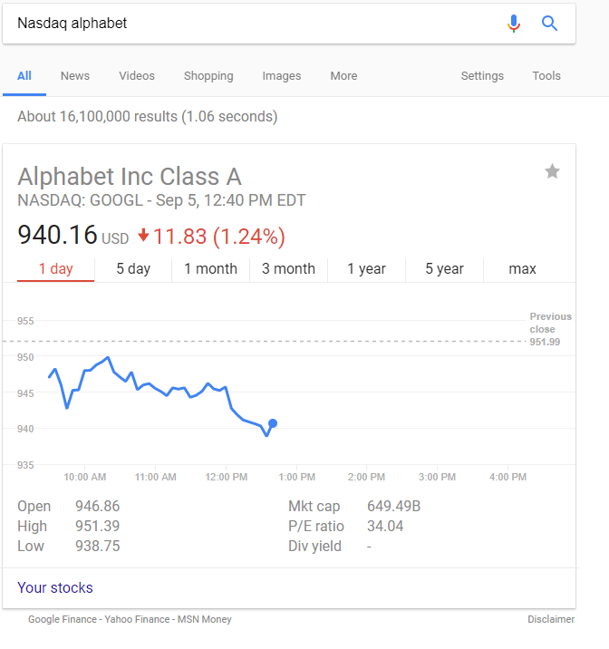
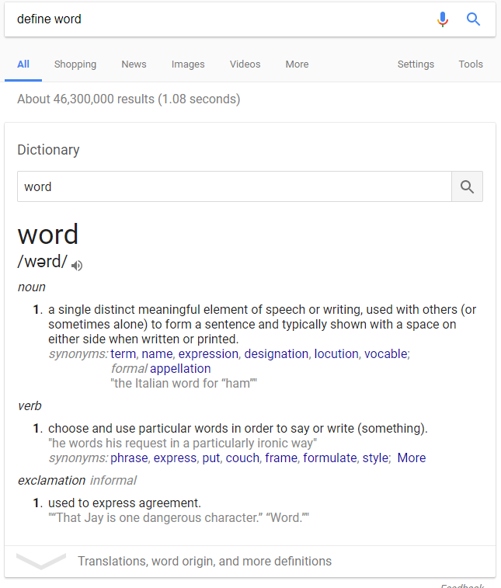
Shortcuts (Everyone knows)
Contact Info
Calculator
Stock Info
Definitions
Movies theatre’s & showtimes
Weather
Etc.
Etc.
Etc.

Slide 4
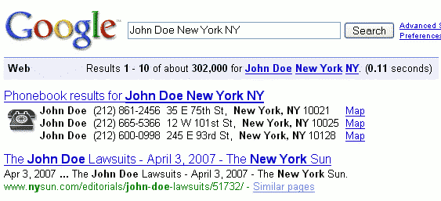
Cancelled:
Personal Phone#’s & Addresses

Slide 5
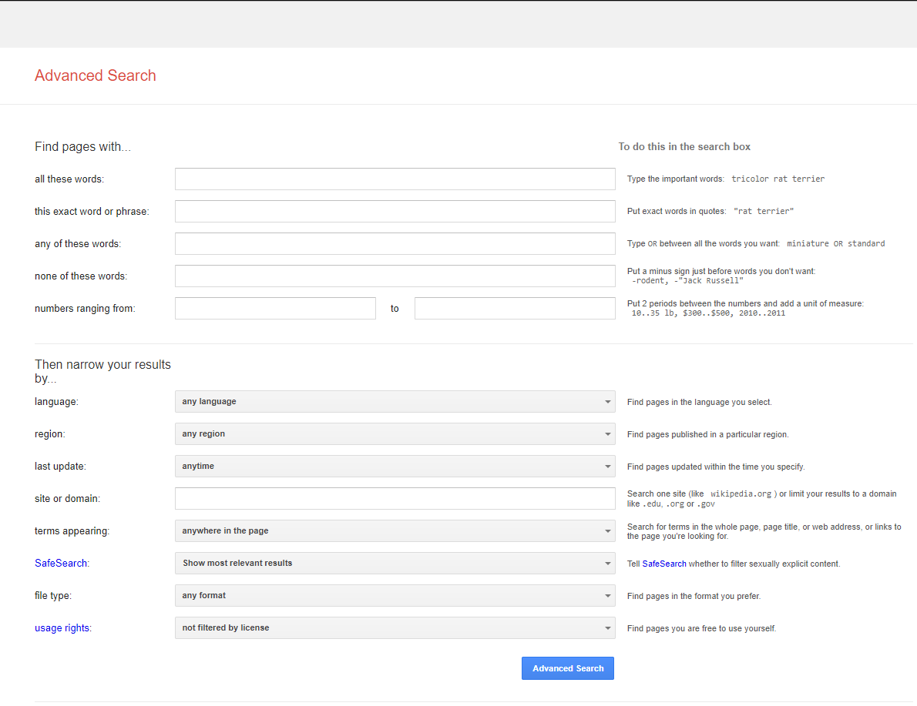
Advanced Search

Slide 6
Common Operators
* (treated as wildcard for 1+ words … not characters)
.. (describes a range of numbers “Russian revolution 1800..2000”)
~ (searches for the word immediately following, as well as ALL synonyms)
- (excludes anything that matches the following word: “Dolphins -football”)
“[quoted text]” (matches quoted text exactly)

Slide 7
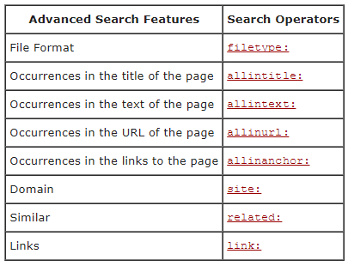
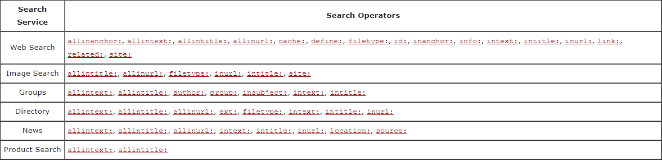
Operators

Slide 8
Combining Operators Is fine
Most of the time
Unacceptable combinations include:
Anything that is mutually exclusive by definition
“Allin…” operators:
allinanchor, allintext, allintitle, allinurl
Operators which limit results to specific pages:
“cache:”, “info:”, “related:”

Slide 9
Bing
AND: Finds webpages that contain all the terms or phrases in a query
Contains: Keeps results focused on sites that have links to the file types that you specify
Define: Triggers an Instant Answer definition for the specified word. Define gravity
Domain: Limits results to the specified domain
Feed: Finds RSS or Atom feeds pertaining to the term you specify
filetype: Returns only webpages of the specified file type.
hasfeed: Finds webpages that contain both the term or terms for which you are querying and one or more RSS or Atom feeds

Slide 10
Bing cont.
imagesize: Constrains the size of returned images
inanchor: Returns webpages that contain the specified term in the anchor text
inbody: Returns webpages that contain the specified term in the metadata or in the HTML body.
intitle: Returns webpages that contain the specified term in the metadata title of the site
ip: Finds sites that are hosted by a specific IP address. The IP address must be a dotted quad address
keyword Metaoperator; that is, an operator that is used with other operators

Slide 11
Bing cont.
language: Returns webpages written in a specific language
literalmeta: Any string within parentheses is interpreted literally
loc: Returns webpages from a specific country or region
meta: Allows the filtering of content based on special tags in HTML
msite: Source filtering used to refine a query for a multimedia site
near: Constrains the distance between terms so that documents that contain instances of the specified terms within ten words of each other are returned before those that don’t
NOT Excludes webpages that contain the specified term or terms

Slide 12
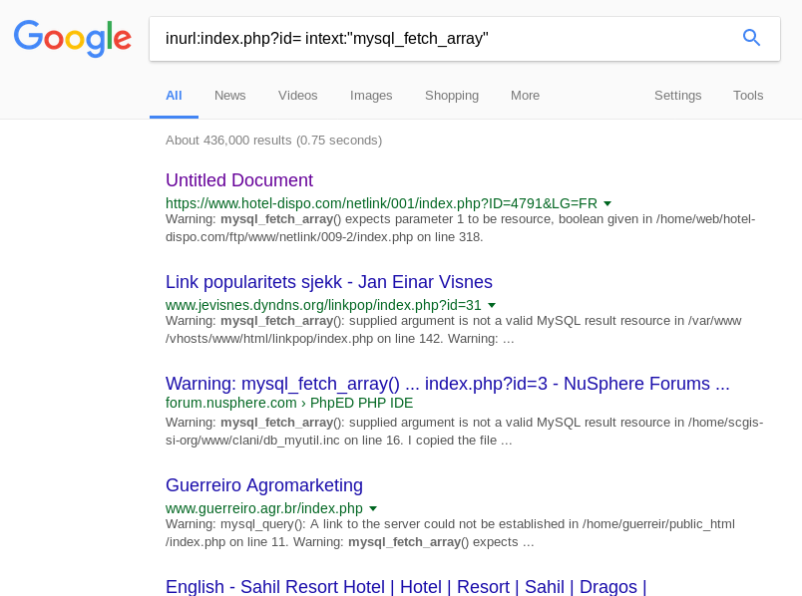
Recon Usage Examples
Find error pages
Find config files / logs
Find login pages
Find ransomware files

Slide 13
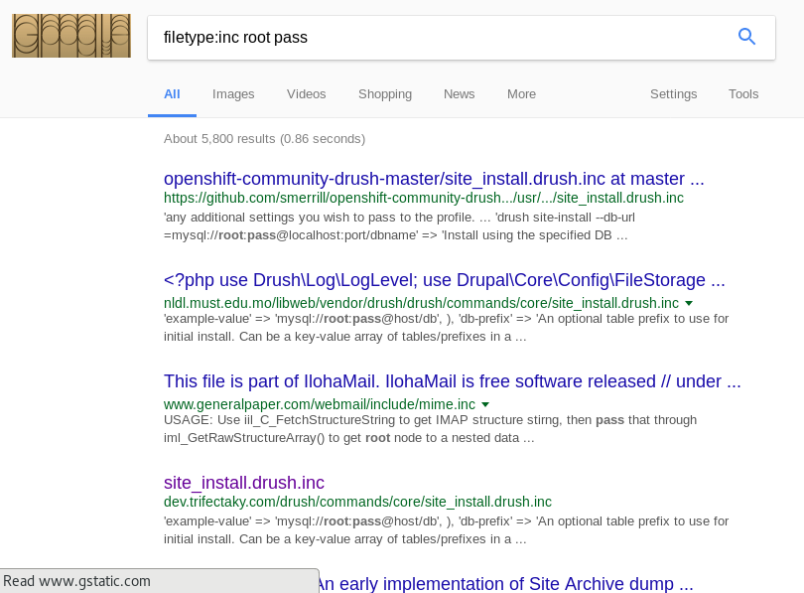
Recon Usage Examples
Find error pages
Find config files / logs
Find login pages
Find ransomware files

Slide 14
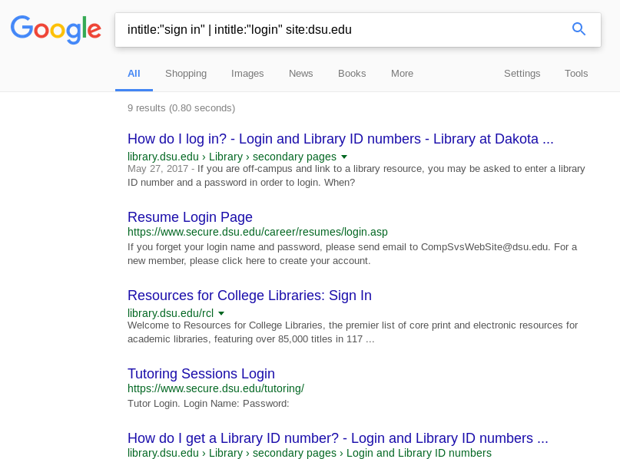
Recon Usage Examples
Find error pages
Find config files / logs
Find login pages
Find ransomware files

Slide 15
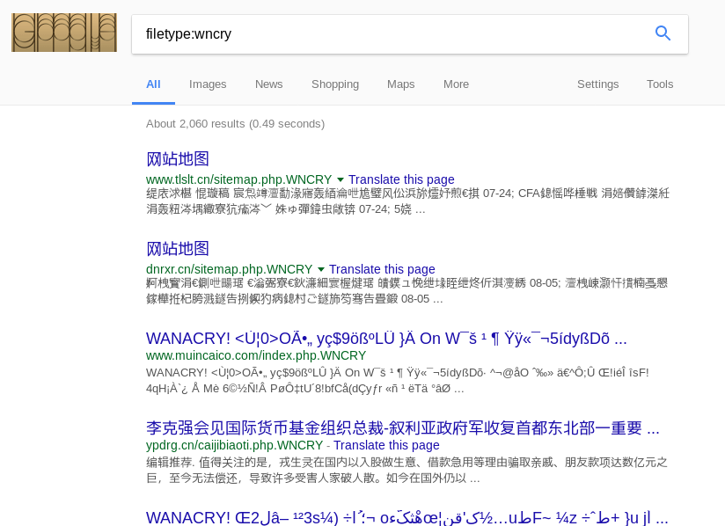
Recon Usage Examples
Find error pages
Find config files / logs
Find login pages
Find ransomware files

Slide 16
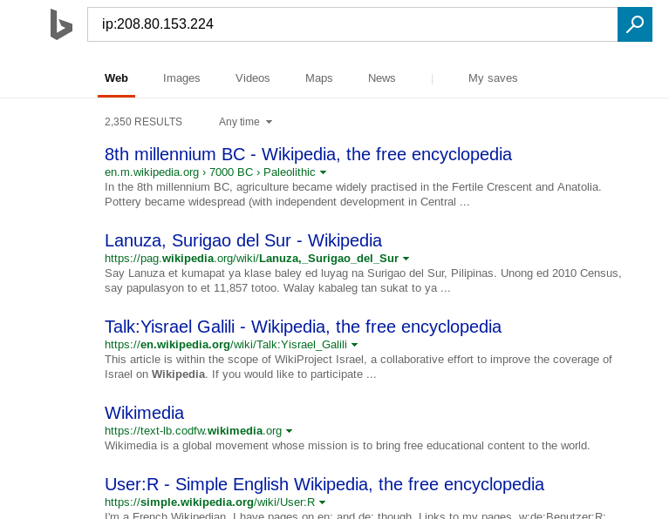
Bing Recon Usage Examples
ip - enumerate domain names associated with an IP
prefer:organization

Slide 17
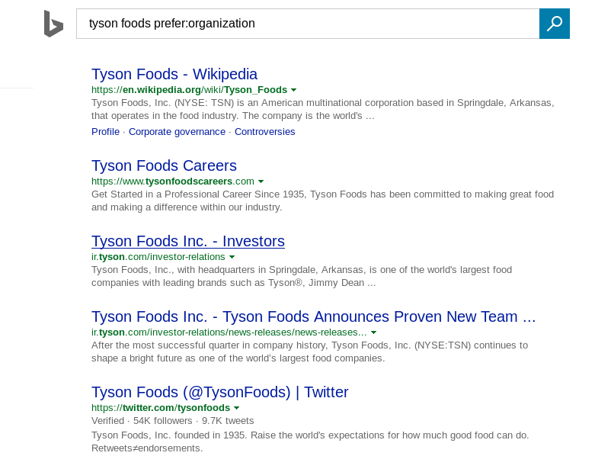
Bing Recon Usage Examples
ip - enumerate domain names associated with an IP
prefer:organization

